Slide 1
Building Storyworlds with Podcasts
John du Pre Gauntt
john.gauntt@theaugmentedcity.io
Notes:
Hi. I’m John Gauntt, the host of The Augmented City Podcast out of Seattle. Since 2016, we’ve explored Artificial Intelligence and Urban Life. Culture & Code. Ultimately, cities are dreams and ideas before they become brick and mortar. That’s especially true for Las Vegas

Slide 2
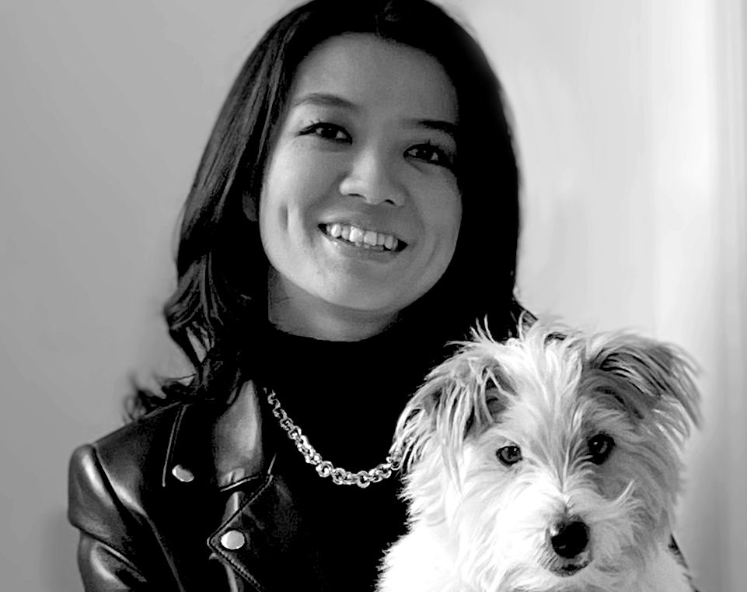
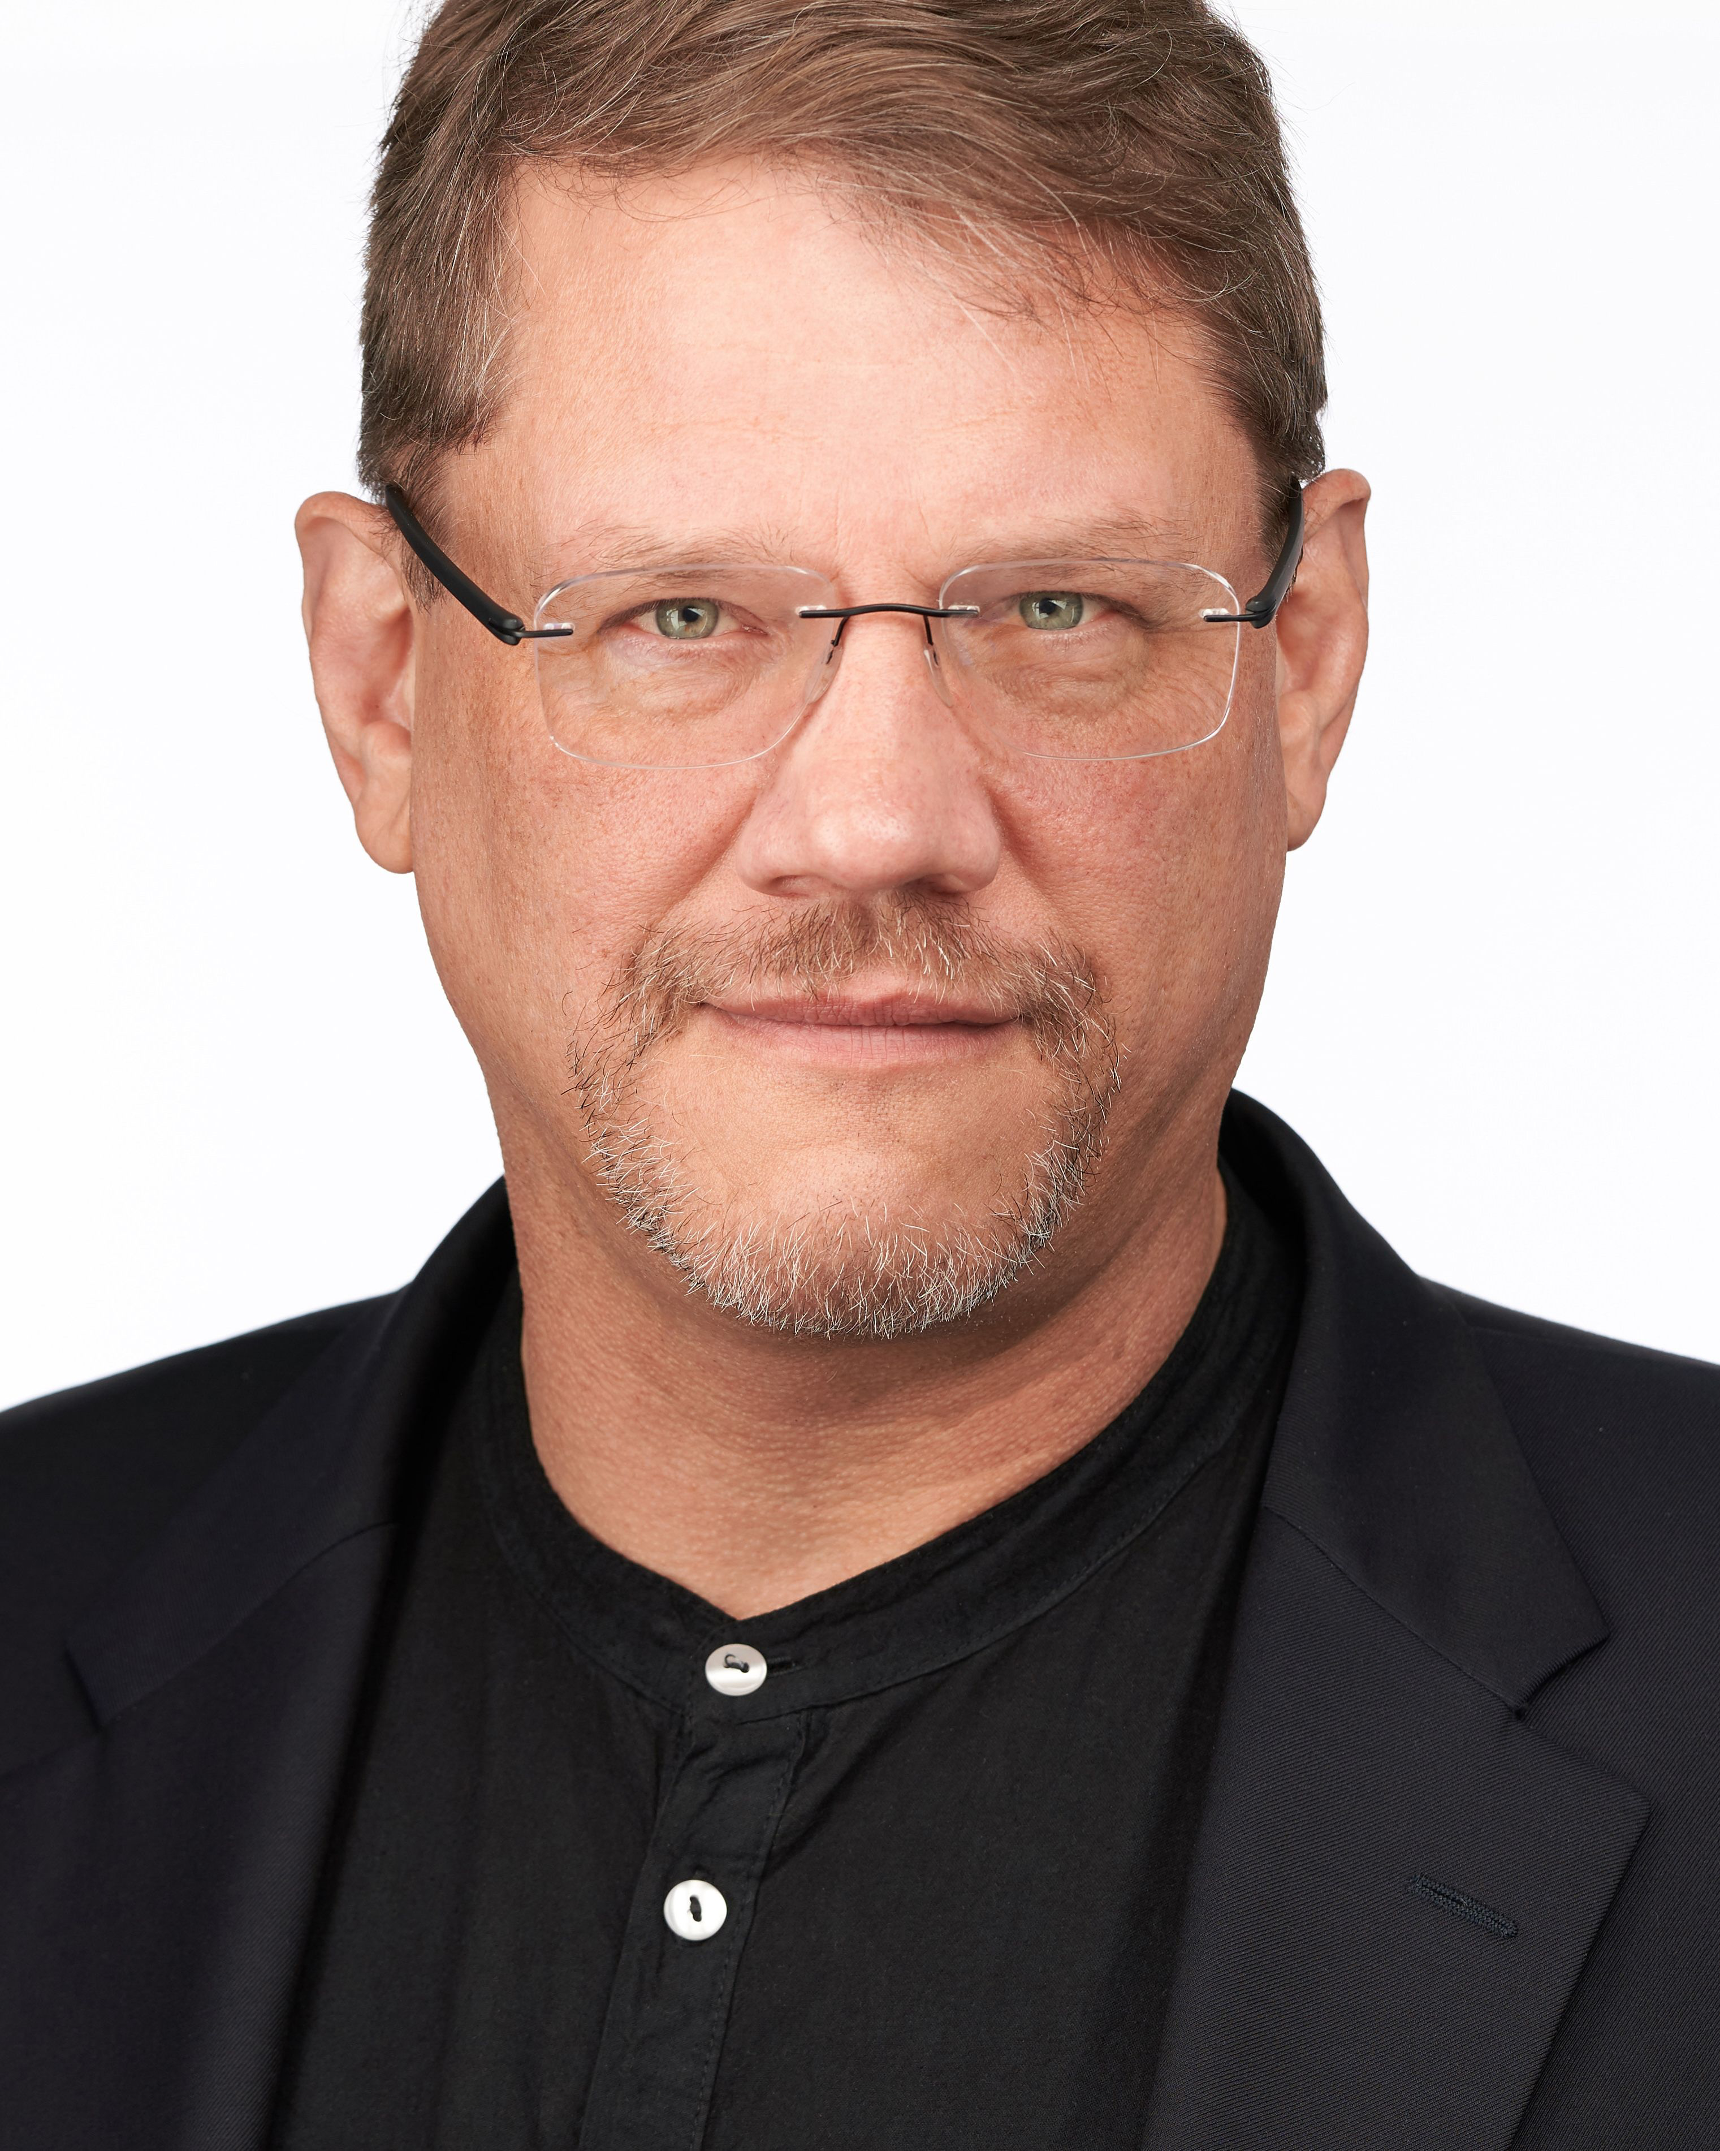
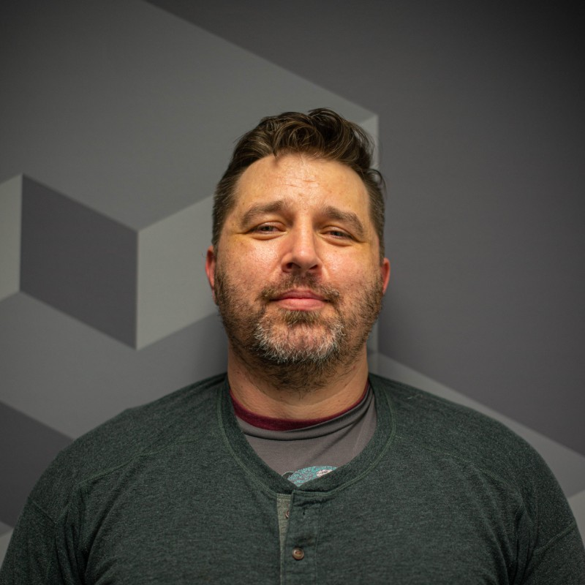
3 People
4 Figures
Create
Work in Progress
5 Weeks
Produce
Notes:
If I said 3 people with 4 figure budget & AI tools took 5 weeks to make this trailer from a Podcast. Would you believe me? Well, that’s what we’re going to cover today.

Slide 3
Human & AI
Co-Creation
Notes:
Today I’ll walk you through how we made this video trailer from a podcast and what we learned about Human & AI Co-Creation. And I’ll tell you the biggest takeaway is that culture & code each have a role and each have a vote. More about that later.

Slide 4
Case Study
Notes:
We’ll walk through the steps we took to transform a podcast script to the video trailer.

Slide 5
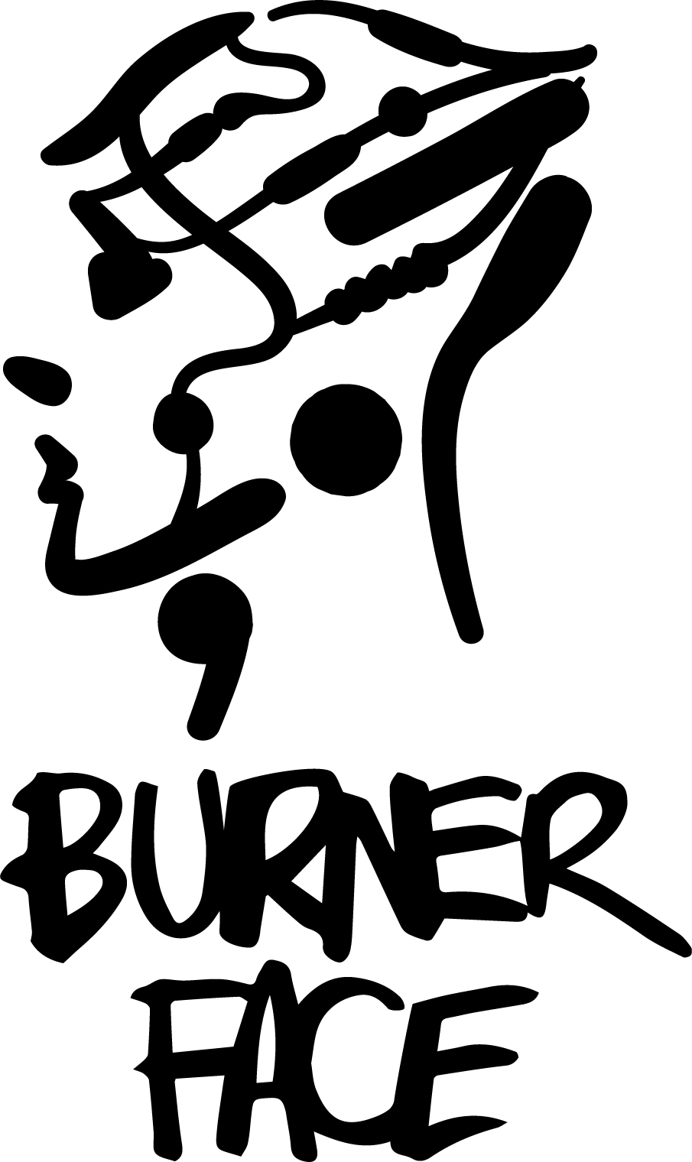
STORY
A century from now, Seattle is hot and muggy. Vincent, Boone & Celeste run the best illegal casino in Puget Sound. It’s a beautiful thing…but no beautiful thing can survive if a Quantum Computer wants to gamble the future.
Notes:
In 2021, we launched an audio fiction series called Burner Face that depicts a plausible City of Seattle in 100 years based on today’s climate and technology futurism. There’s flying cars and talking cats as one would expect in a proper sci-fi detective noir. However, all the settings, situations and gadgets are based on real-world science and technology.

Slide 6
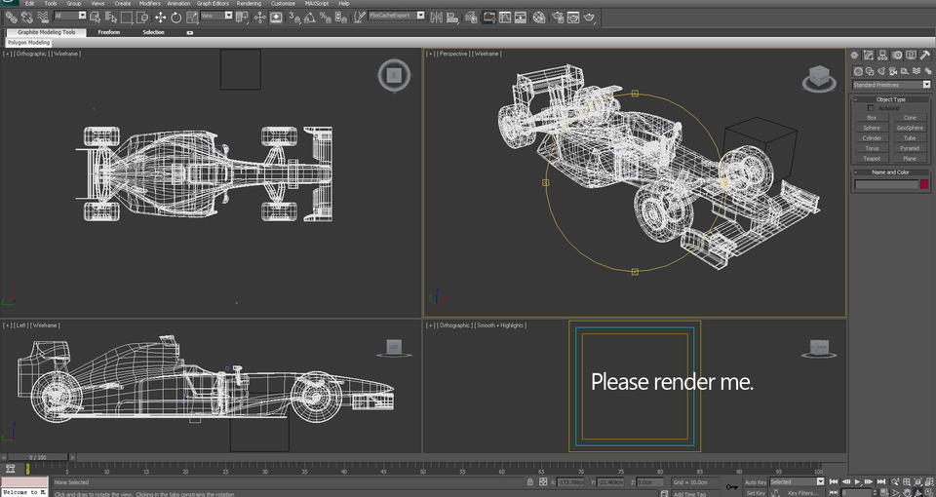
CONCEPT CAR
Notes:
We believe the next Internet is already here. It’s more head’s up, 3D and hand’s free. We further believe there is a greenfield opportunity for storytelling that exists somewhere between a podcast, a graphic novel and a film. This is where we are poking around.
This meant Burner Face needed to prove itself as a creative story first. Only then it made sense to push the *storytelling* innovation of people, process and technology.

Slide 7
Core Team
Beini Huang
1.) Visuals
2.) Text
John Gauntt
1.) Writing
2.) Audio
Keith Ancker
1.) Audio
2.) Web
Notes:
Quick overview of the team. More about the rankings later.
Beini Huang is a portrait artist, an illustrator, and animator with clients including Netflix and National Geographic. She’s based in New York.
Keith Ancker is an audio showrunner who placed 2 shows at SXSW and worked with sponsors like New Belgium Brewing in e-sports category.
I come from the B2B consulting space as a market analyst and technology writer/producer for clients like Economist Intelligence Unit and Citibank Ventures

Slide 8
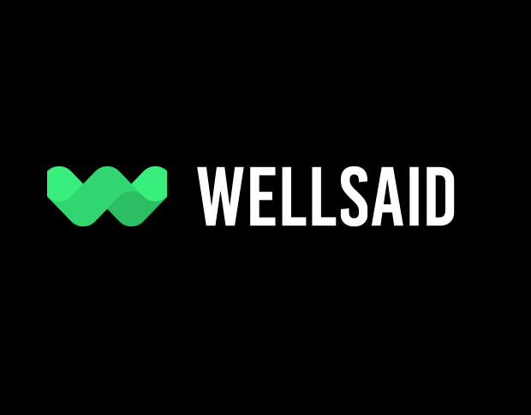
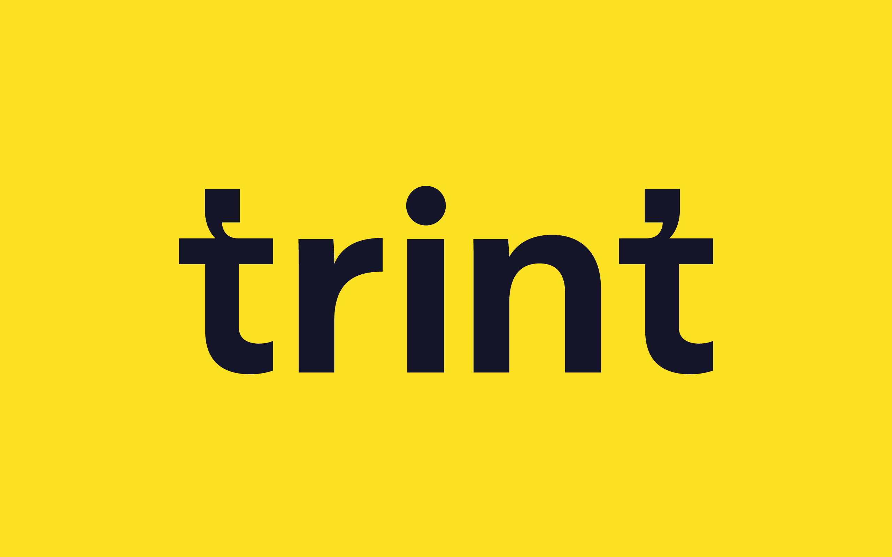
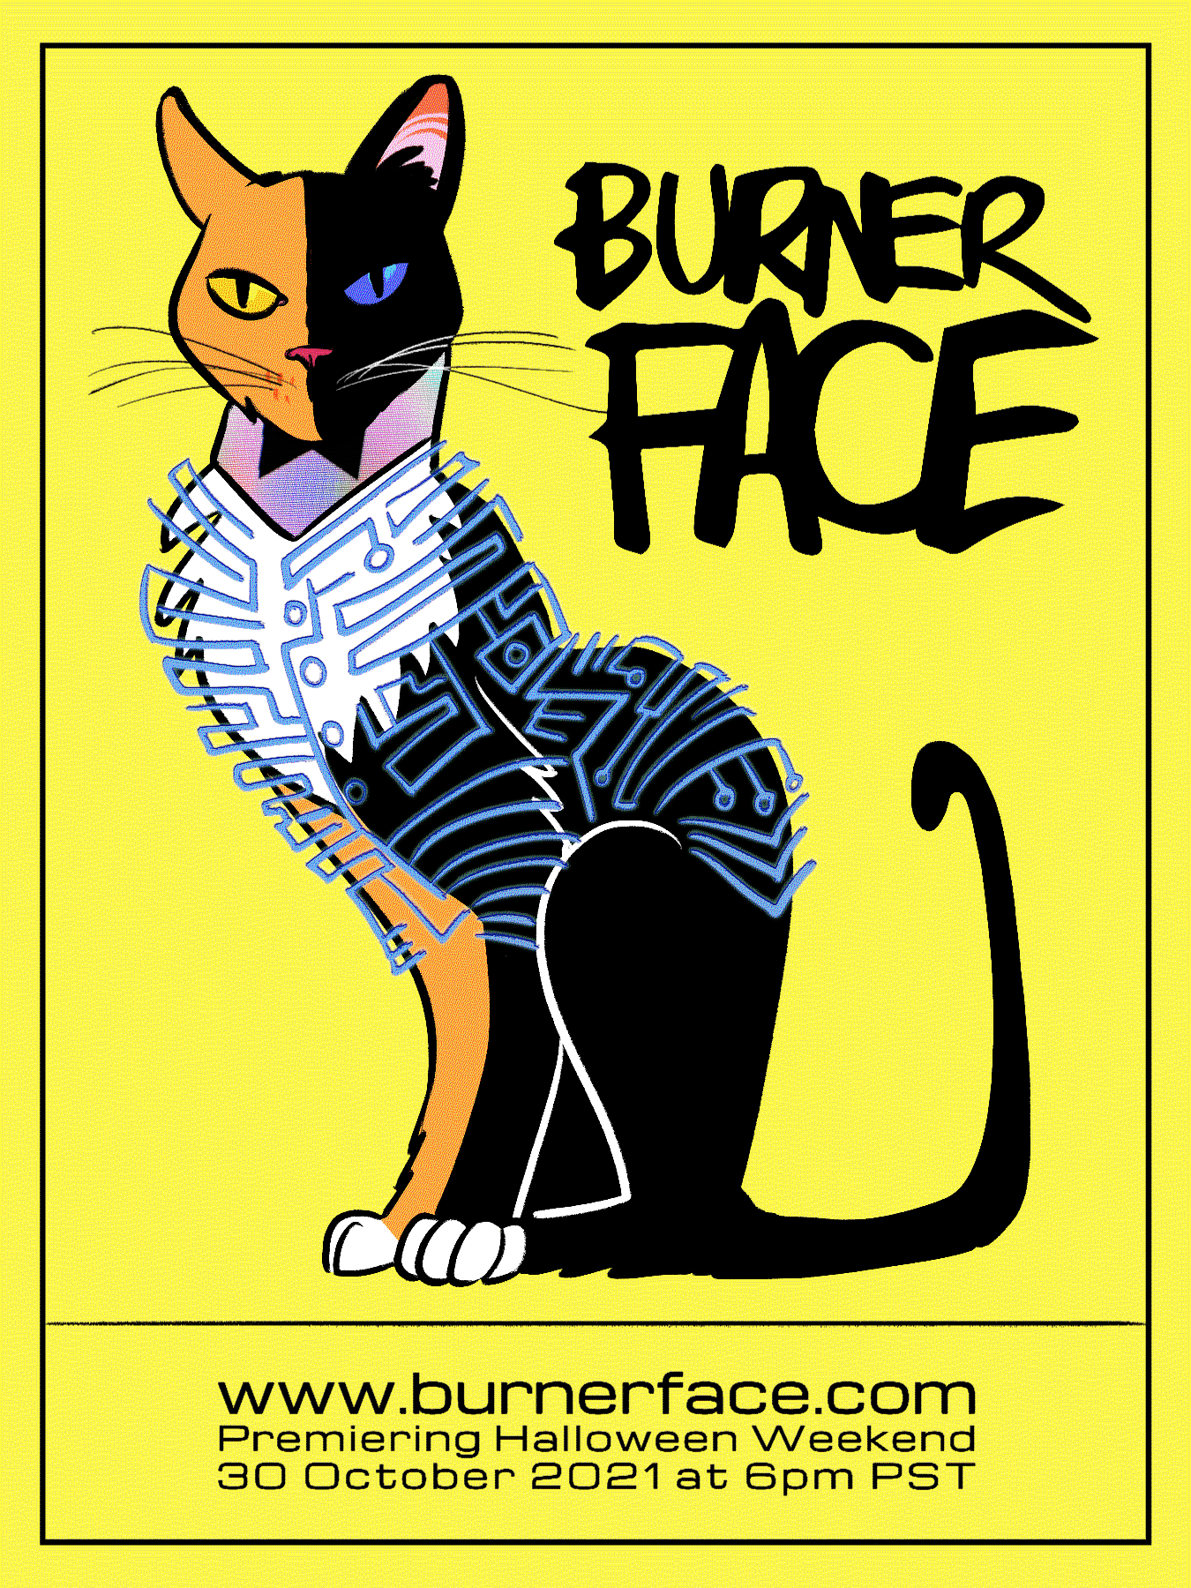
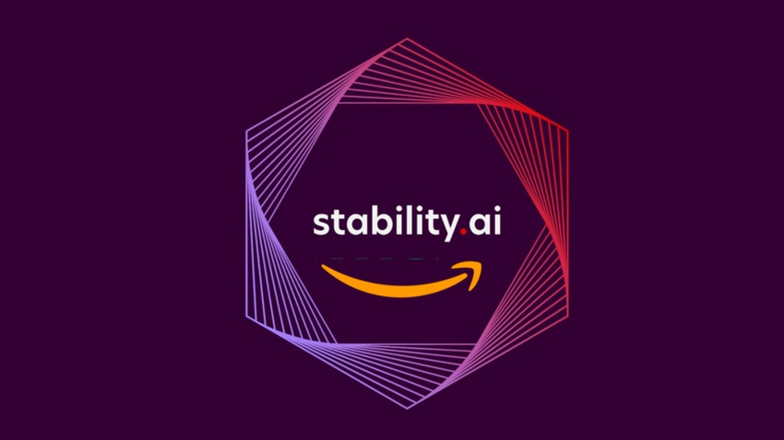
Inventory
Original Assets
AI Tools
Media Tools
Notes:
This was the starting point. We had archived scripts in PDF. We had voice tracks and SFX mixed and separate. Beini Huang created a rich and varied visual language for Burner Face Season 1 with covers, characters studies and the like.
Along with assets, we’ve used AI in our production processes for everything. Midjourney and Stable Diffusion were the new platforms we adopted last summer.
After that, it was all standard digital media platforms, Adobe Audition for sound and Aftereffects for putting it all together. We collaborated on draft with Vimeo.

Slide 9
Timeline (5wks)
Create
WIP
Produce
Write
Rewrite
Review
Storyboard
Re-Draft
Approve
Assemble
Animate
Package
Notes:
Nothing to see here. You’ll still go through the same steps.

Slide 10
Timeline (5wks)
Create
WIP
Produce
Float(s)
Time
Skills
Complexity
Costs
Notes:
However, this is where you learn. AI effects floats all across your creative projects. With the right mentality, it’s a feature not a bug.

Slide 11
Key Decisions
Core Team → story
Midjourney → landscapes
Beini Huang → characters
Notes:
The biggest decision aren’t about which platform, but how to divvy the work across a team so that everyone plays from a position of strength, human and AI alike.
In the 5wk period the most concentrated time was on getting the story right first. It wasn’t copy paste from a podcast script, It was how to fit podcast assets into a story. You’ll note the asterisk. That’s gonna be a more interesting question in about a year.
Then Midjourney for landscapes.
And Beini was responsible for the characters and the final render.

Slide 12
CREATE

Slide 13
Notes:
This is probably the most important slide of the deck. It’s an old copy of a trailer script we rejected. But it illustrates how to picture the whole thing and the jobs you hire different content to do.

Slide 14
Trailer Script
Notes:
So here’s piece of trailer script you saw

Slide 15
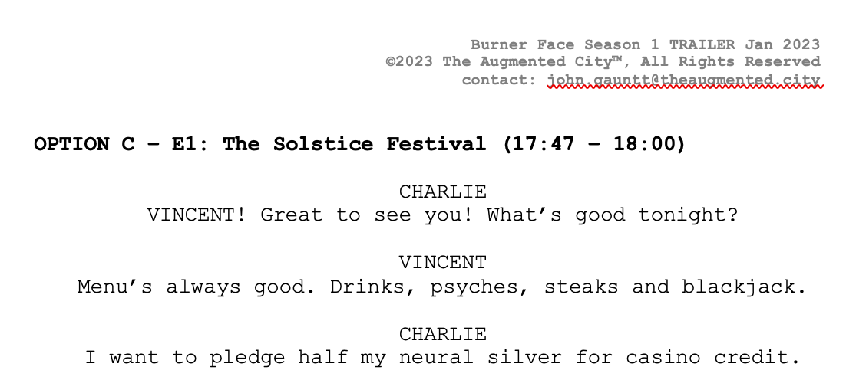
Notes:
Step 2 was to go back to the finished podcast scripts, and find audio cuts that exemplify the narrative you just wrote. One line of trailer script needed three options from the podcast scripts. Then you edit.

Slide 16
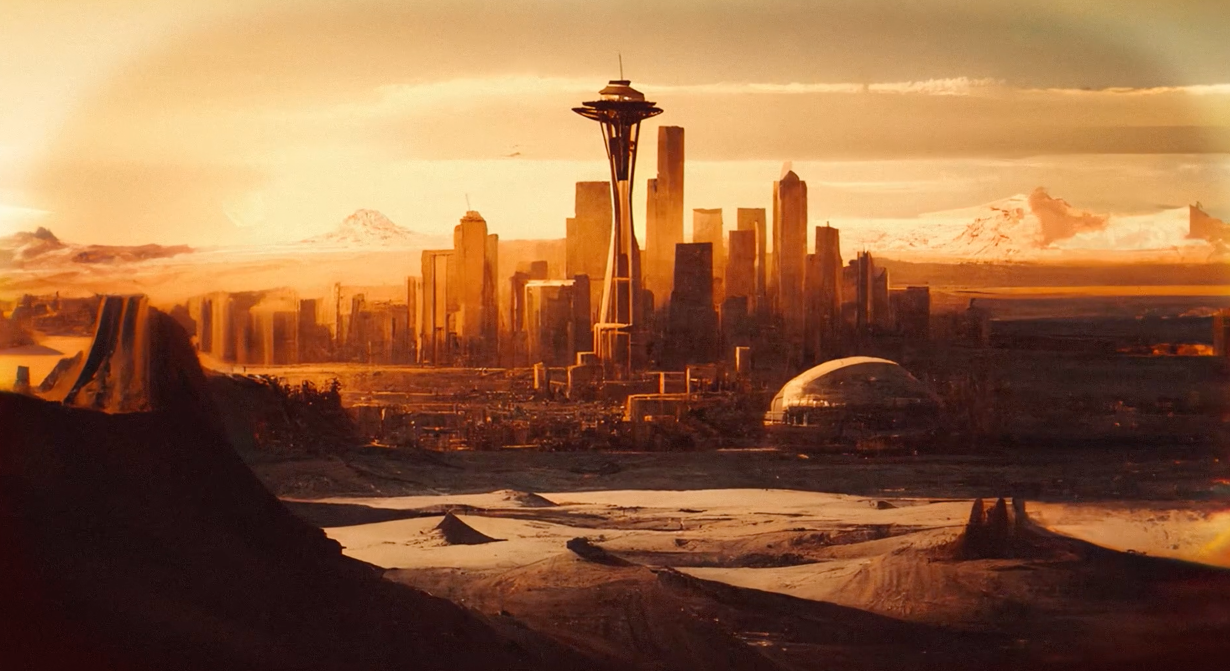
Notes:
We entered our first set of text prompts, set some resolutions, and got this back as our very first panel of storyboard. Anyone want to guess what’s wrong with this picture and why?
Seattle looks like it’s sitting in Utah Desert. Why? Midjourney trained on a Large Language Models, In other words, Midjourney learned what scraping the Internet had to teach. The Internet taught that when most people think about a hot future, they think about a hot and dry future more than a muggy and moist future.

Slide 17
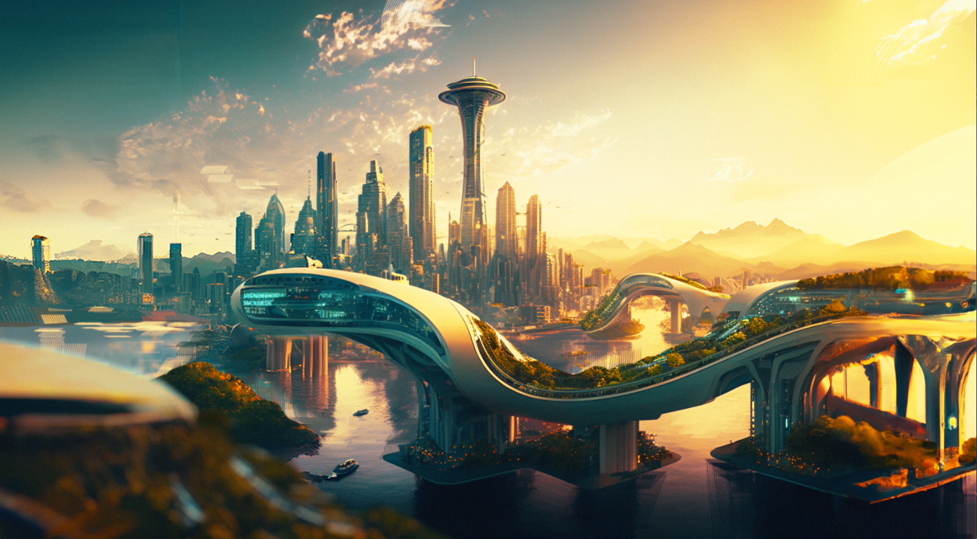
Notes:
So we went back to Midjourney and rewrote our descriptions in plain language. But that j

Slide 18
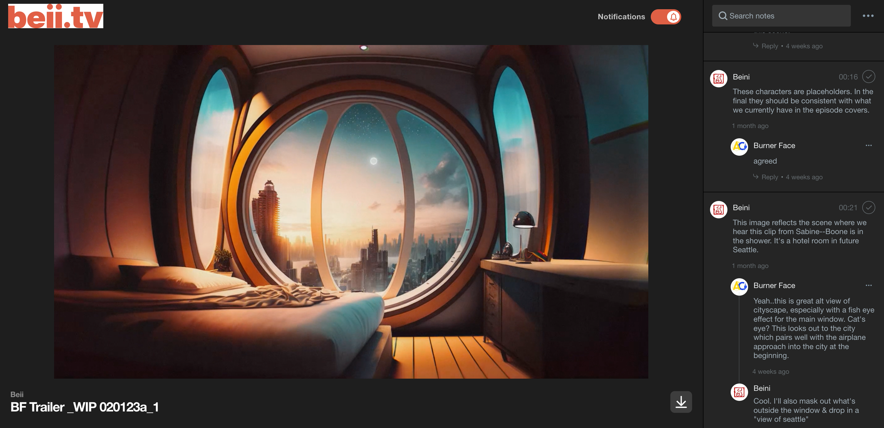

Slide 19
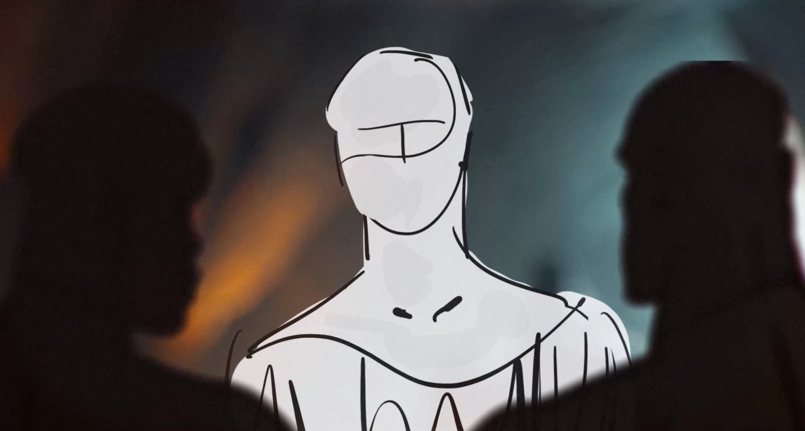

Slide 20
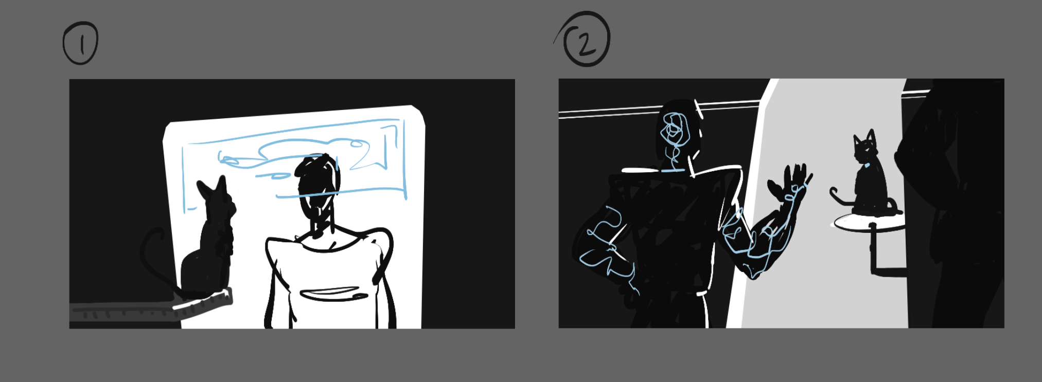
Perspectives

Slide 21
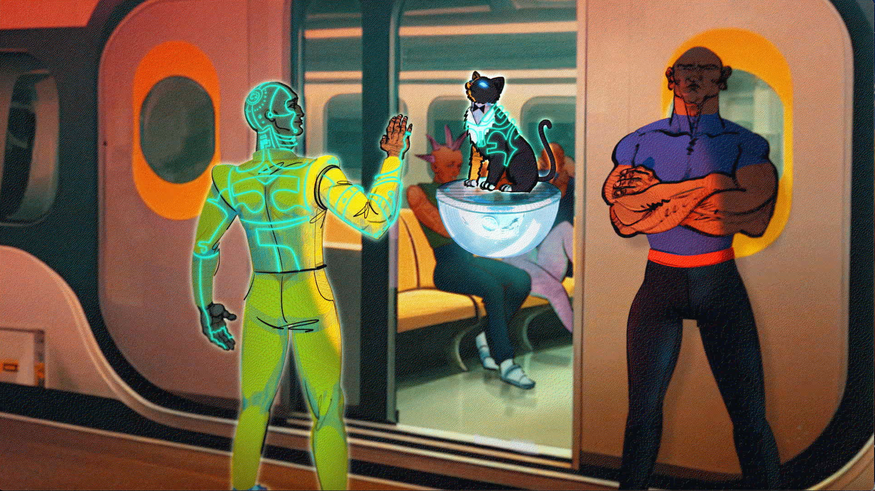

Slide 22
Produce

Slide 23
Key Learnings (Technology)
WINS:
1.) Midjourney collapsed STORYBOARDING for landscapes and interiors
By iteration ~3, the asset was >75% complete
2.) Rich landscape/interior assets helped character dev. even more
CAVEATS:
1.) AI generates against what’s popular, not what’s good.
2.) Articulate your vision as precisely as possible...then evolve it.
Notes:
Generative AI blurs the lines between WIP and production
Generative AI is awesome for two main use cases:
Rapid quality development of a well-formed idea to 99%
Spitballing new ideas quickly to 35- 40%

Slide 24
Key Learnings (Process)
1.) Use AI as a tool, not an answer machine.
2.) There’s a lot of tweaking to harmonize a creative style with AI assets.
3.) Deliberately select areas to WANDER CREATIVELY. Figure out where you want to be efficient and where you want to push yourself.
4.) Don’t be afraid to push AI in new directions. Revisit your founding assumptions regularly.
Notes:
Generative AI blurs the lines between WIP and production
Generative AI is awesome for two main use cases:
Rapid quality development of a well-formed idea to 99%
Spitballing new ideas quickly to 35- 40%

Slide 25
Key Learnings (People)
1.) Core team members need to speak more than one medium.
2.) Imagine like an artist. Create like an art director.
3.) Human Language is a programming language.
Notes:
Generative AI blurs the lines between WIP and production
Generative AI is awesome for two main use cases:
Rapid quality development of a well-formed idea to 99%
Spitballing new ideas quickly to 35- 40%

Slide 26
What’s Next?

Slide 27
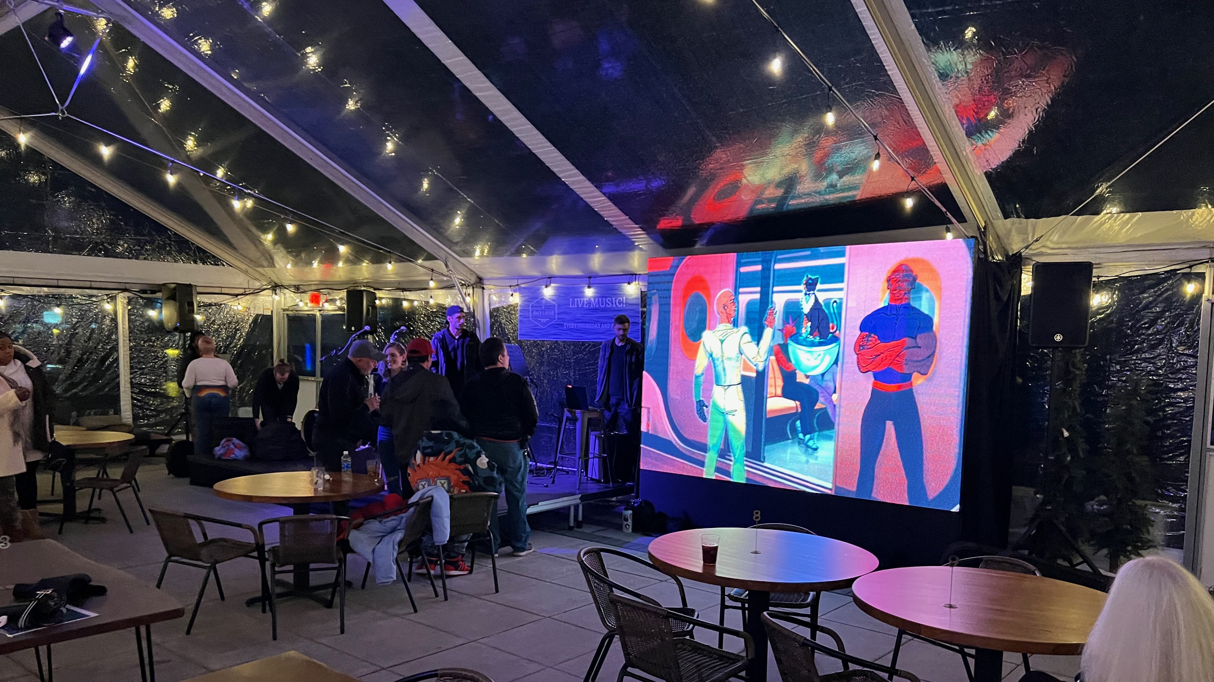

Slide 28
Season 2 Launch 2023

Slide 29
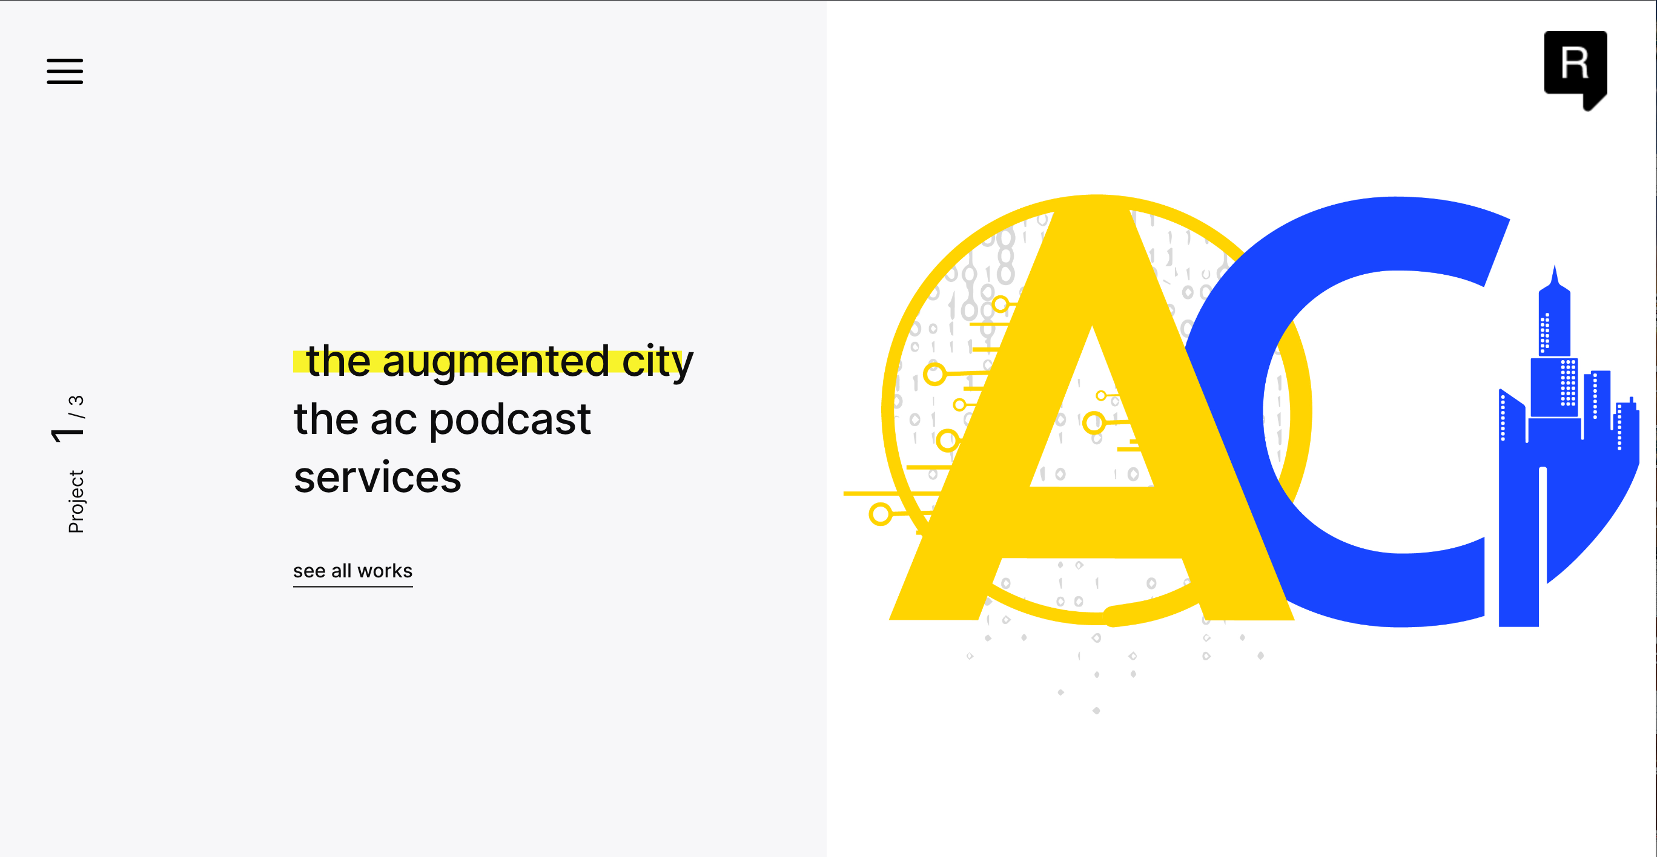
https://theaugmentedcity.io

Slide 30
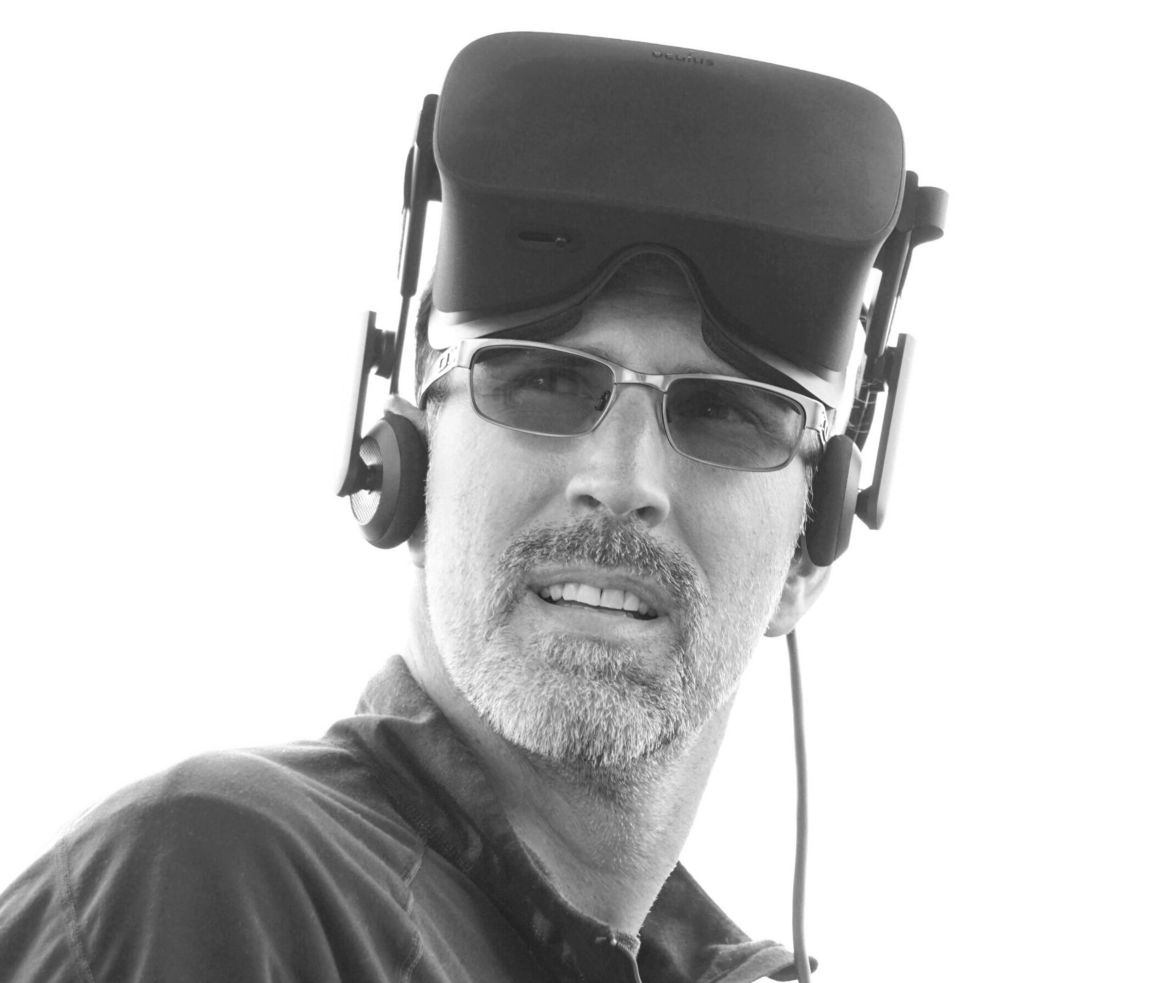
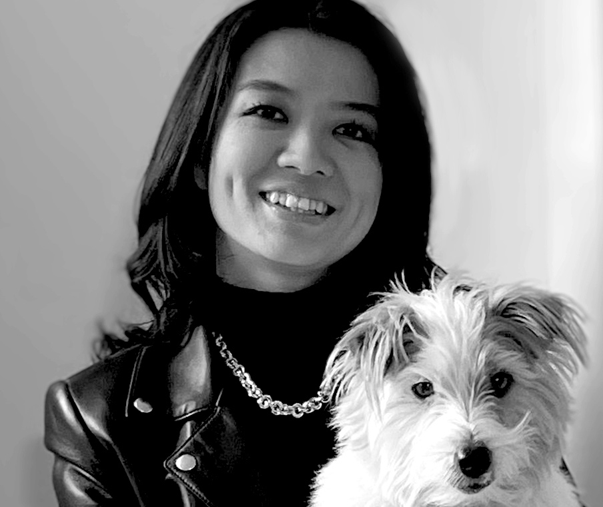
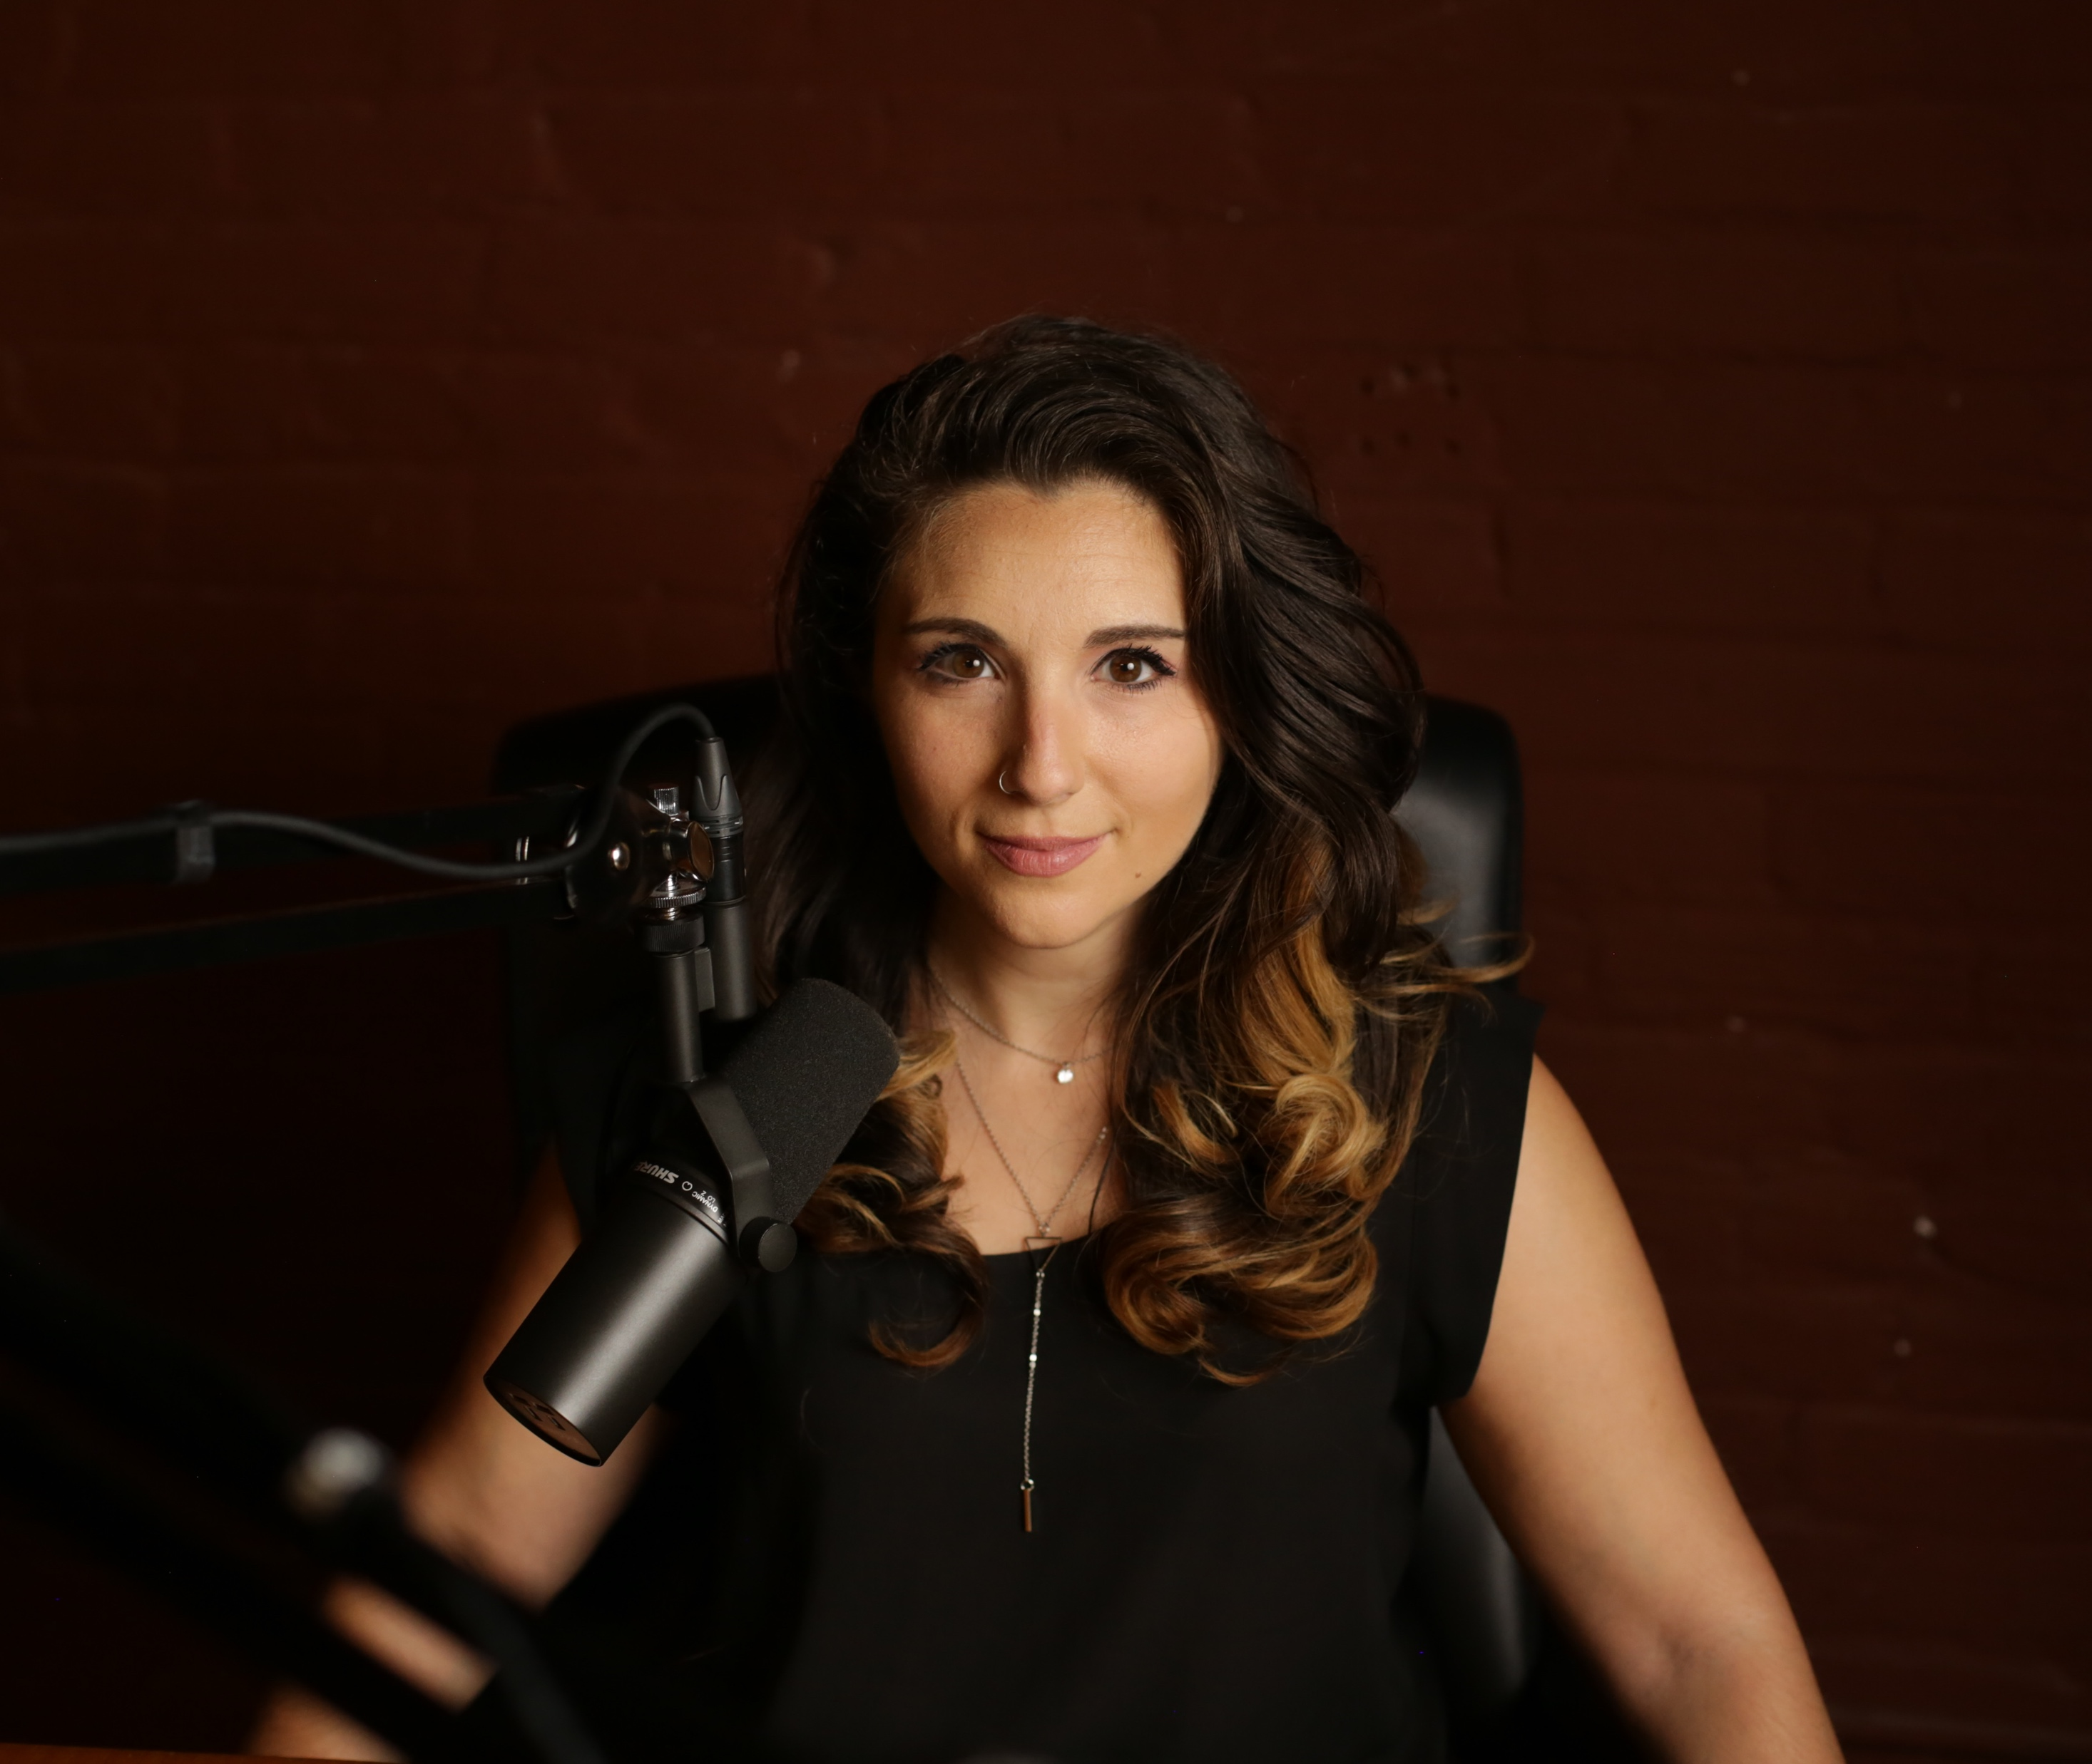
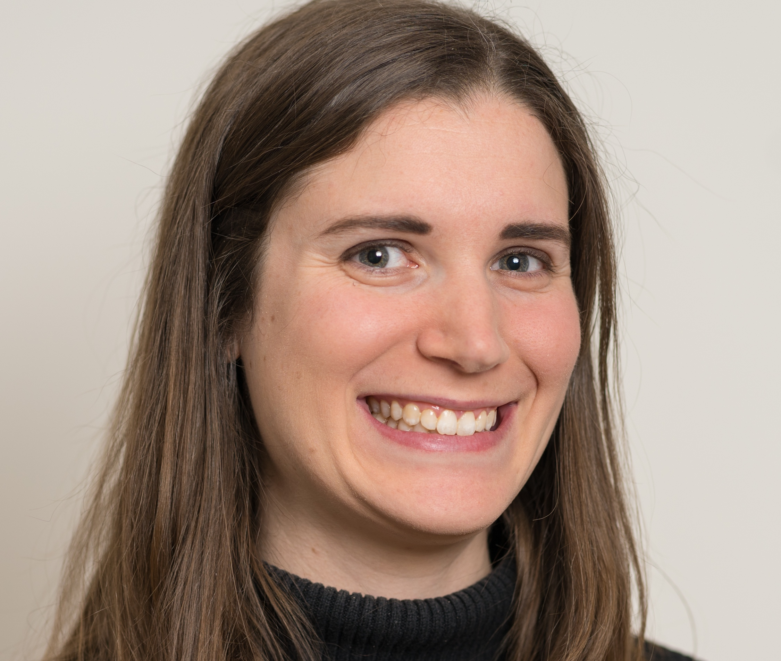
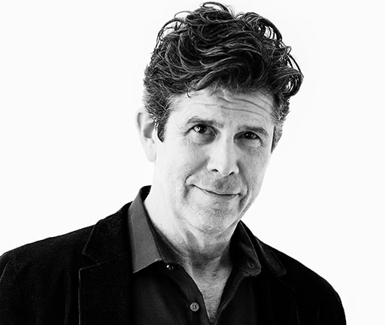
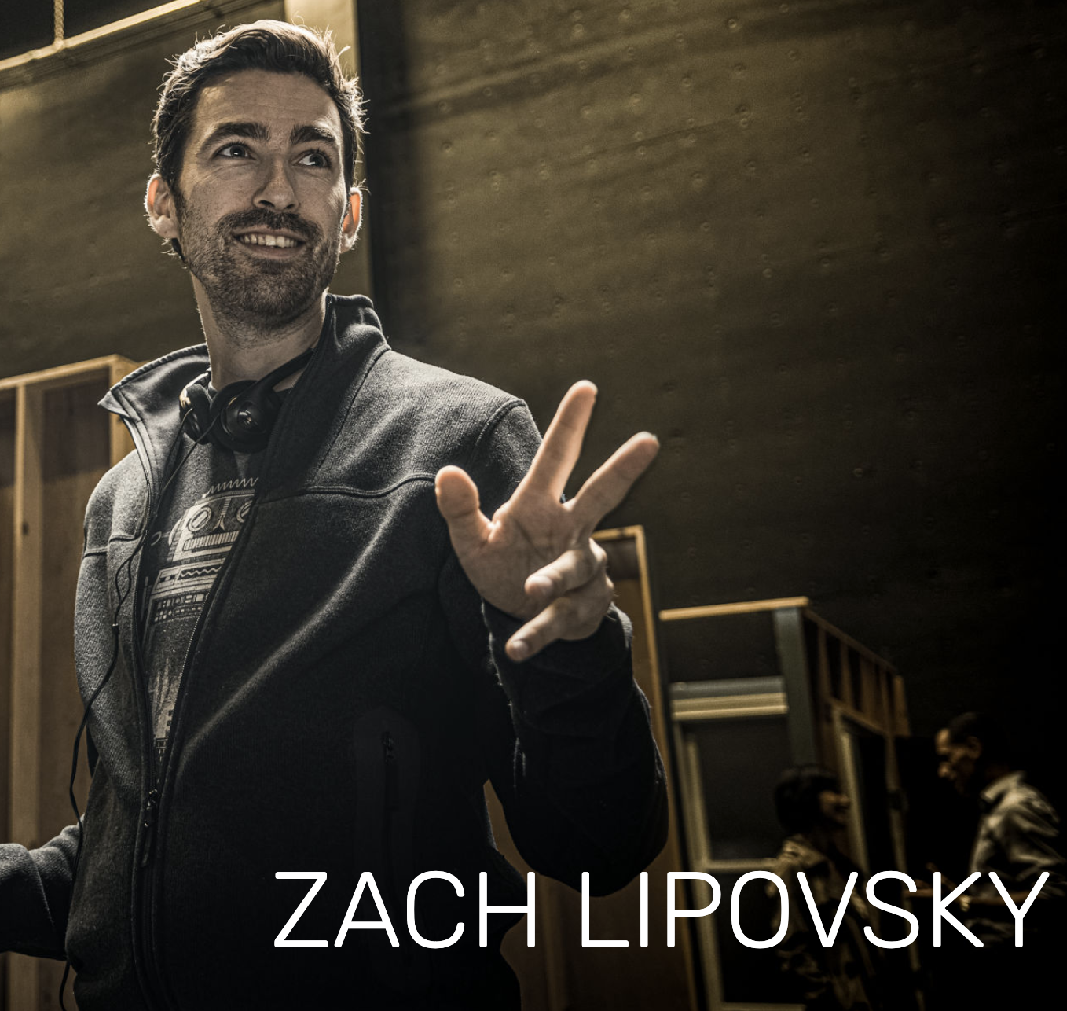
Notes:
Given that, I interviewed ten leading creators and strategists about the shifting media environment and rapid advances in technology, especially artificial intelligence. I asked these innovators how they intend to ride this next wave of change, and how they want to collaborate with the podcasting community.

Slide 31
THE AUGMENTED CITY
Extensible Audio Storytelling
CONTACT:
John Gauntt john.gauntt@theaugmentedcity.io
+1-206-618-8131
Keith Ancker keith.ancker@theaugmentedcity.io
+1-206-354-5081
https://theaugmentedcity.io

